Slide 1
Introduction to Probability and Probability Distributions
Probability?
Continuous probability distributions?
Discrete probability distributions?
The concept of probability is an important aspect of the study of statistics and within this presentation we shall introduce the reader to some of the concepts that are relevant to probability distributions.
However, the main emphasis of the chapter is to focus on the concepts of discrete and continuous probability distributions and not on the fundamentals of probability theory.

Slide 2
Learning Objectives
On completing this unit you should be able to:
Understand key probability terms, such as: experiment, outcome, sample space, relative frequency, sample probability, mutually exclusive events, independent events, and tree diagrams.
Identify a continuous probability distribution and calculate the mean and variance.
Identify a discrete probability distribution and calculate the mean and variance.
Solve problems using Microsoft Excel and IBM SPSS software packages.

Slide 3
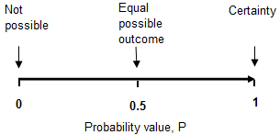
Basic Ideas
There are a number of words and phrases that encapsulate the basic concept of probability: chance, probable, odds. In all cases we are faced with a degree of uncertainty and concerned with the likelihood of a particular event happening. Statistically these words and phrases are too vague; we need some measure of likelihood of an event occurring. This measure is termed probability and is measured on a scale ranging between 0 and 1.
In order to determine a probability of an event occurring, data has to be obtained. This can be achieved through, for example, experience (subjective) or observation (empirical, relative frequency) or theoretical (a priori, deductive reasoning) methods.
The procedure or situation that produces a definite result (or outcome) is termed a random experiment. For example tossing a coin, rolling a die, recording the income of a factory worker, determining defective items on an assembly line are all examples of 'experiments'.

Slide 4
Relative Frequency
Consider the result of running the die experiment where the die has been thrown 10 times and the number of times each possible outcome (1, 2, 3, 4, 5, and 6) recorded. Now consider the result of running the die experiment where the die has been thrown 1000 times and the number of times each possible outcome (1, 2, 3, 4, 5, and 6) recorded. The result of this die experiment is also illustrated in Table 3.2.
Rules
The probability of each event lies between 0 and 1.
The sum of the probabilities of these events will equal 1.
If we know the probability of an event, then the probability of it not occurring is P(Event not occurring) = 1 - P(Event occurs)
Score | 1 | 2 | 3 | 4 | 5 | 6
Frequency for 10 | 3 | 1 | 2 | 1 | 0 | 3
Relative frequency | 0.300 | 0.100 | 0.200 | 0.100 | 0.000 | 0.300
Frequency for 1000 | 173 | 168 | 167 | 161 | 172 | 159
Relative Frequency | 0.173 | 0.168 | 0.167 | 0.161 | 0.172 | 0.159
In general, if event A occurs m times, then your estimate of the probability that A will occur is as follows:

Slide 5
The Probability Laws
In case we are measuring probabilities for multiple events, very often we would like to be able to calculate what is the probability that either one or the other event will happen, or the probability that both events will happen simultaneously.
Addition Law:
Mutually Exclusive Events:
P(A or B) = P(A) + P(B) – P(A and B)
P(A and B) = 0
Independent Events:
P(A /B) = P(A)
implies P(A and B) ≠ 0
Multiplication Law for 2 Events:
Multiplication Law for 2 Independent Events:
P(A and B) = P(A/B) x P(B)
P(A and B) = P(A) x P(B)

Slide 6
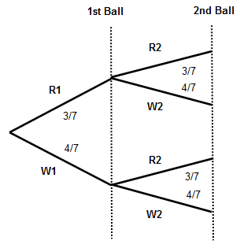
Probability Tree Diagram
Probability tree diagrams provide a visual aid to help you solve complicated probability problems.
A bag contains 3 red and 4 white balls. If one ball is taken at random and then replaced and the another ball is taken calculate the following probabilities: (a) P(R, R), (b) P(just one Red), (c) P(2nd Ball White)?
Figure displays the experiment in a tree diagram. Each branch of the tree indicates the possible result of a draw and associated probabilities.
We can now use this diagram to calculate the required probabilities, e.g.
P(R, R) = P(R1) x P(R2) = 9/49

Slide 7
Discrete and continuous random variables
A random variable is a variable that provides a measure of the possible values obtainable from an experiment. For example, we may wish to count the number of times that the number 3 appears on the tossing of a fair die or we may wish to measure the weight of people involved in measuring the success of a new diet programme.
Let the random variable consist of the numbers: 1, 2, 3, 4, 5, or 6. If the die was fair, then on each toss of the die each possible number (or outcome) will have an equal chance of occurring. The numbers 1, 2, 3, 4, 5, or 6 represent the random variable for this experiment. As the values are the whole number answers (not a continuum such as 1.1, 1.2 etc.) then this is an example of a discrete random variable. Several discrete probability distributions will be discussed in this and other chapters within this text book, including: binomial, and Poisson.
If the numbers can take any value with respect to measured accuracy (160.4 Ibs, 160.41Ilbs. 160.414 Ibs, and so on), then this is an example of a continuous random variable. In this chapter, we will explore the concept of a continuous probability distribution with the focus on introducing the reader to the normal probability distribution. However, several other continuous probability distributions will be discussed in this and other chapters within this text book, including Student’s t distribution, chi square distribution, and the F distribution.

Slide 8
Continuous Probability Distributions
A random variable is a variable that provides a measure of the possible values obtainable from an experiment.
For example, we may wish to count the number of times that the number 3 appears on the tossing of a fair die or we may wish to measure the weight of people involved in measuring the success of a new diet programme.
The second example consists of numbers that can take any value with respect to measured accuracy (160.4 Ibs, 160.41Ilbs. 160.414 Ibs, etc) and is an example of a continuous random variable.
In this section we shall explore the concept of a continuous probability distribution with the focus on introducing the reader to the concept of a Normal probability distribution.

Slide 9
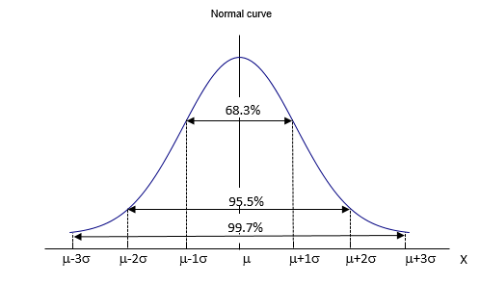
The Normal Distribution
When a variable is continuous, and its value is affected by a large number of chance factors, none of which predominates, then it will frequently appear as a Normal distribution. This distribution does occur frequently and is probably the most widely used statistical distribution. Some of the real-life variables having a Normal distribution can be found, for example, in manufacturing (weights of tin cans), or can be associated with the human population (people's heights).
The Normal distribution is governed by equation (3.5):
Bell shape,
Symmetry,
Mean = Median = Mode

Slide 10
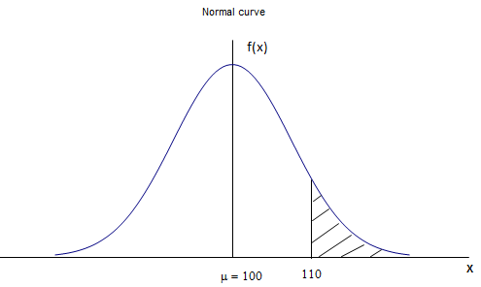
Example 3.3
A manufacturing firm quality assures components manufactured and historically the length of a tube is found to be normally distributed with the population mean of 100 cms and a standard deviation of 5 cms. Calculate the probability that a random sample of one tube will have a length of at least 110 cms?
From the information provided we define X has the tube length in cms and population mean µ = 100 and standard deviation = 5.
X ~ N (100, 5²)
The problem we have to solve is to calculate the probability that 1 tube will have a length of at least 110 cms. This can be written as P(X ≥ 110).

Slide 11
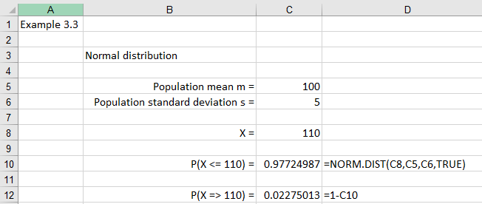
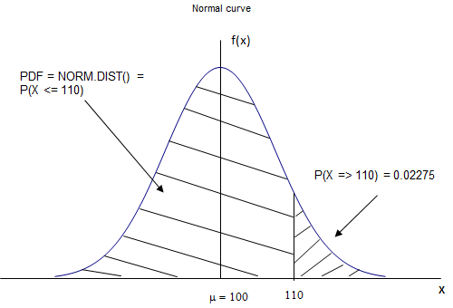
Example 3.3 Excel solution
This can be written as P(X ≥ 110) and is represented by the shaded area.
This problem can be solved by using the Excel function NORM.DIST (X, µ, σ, TRUE).
P(X ≥ 110) = 0.02275
From Excel, we observe that the probability that an individual tube length is at least 110 cm is 0.02275, or 2.3%

Slide 12
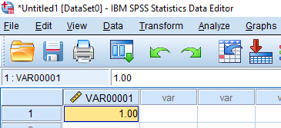
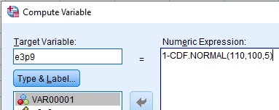

Example 3.3 SPSS solution
Enter data into SPSS
Note that in these examples we have no data to input but we must enter a data value to be able to use the methods described below. In this example, we have entered the number 1 into column 1 (VAR00001).
Select Transform > Compute Variable
Target Variable: e3p9
Numeric expression = 1 – CDF.NORMAL (110, 100, 5)
Click OK
The value will not be in the SPSS output file but in the SPSS data file in a column called e3p9

Slide 13
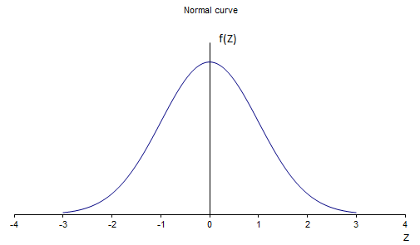

The Standard Normal Distribution
If we have two different populations, both following normal distribution, it could be difficult to compare them as the units might be different, the means and variances might be different, etc. If this is the case, we would like to be able to standardize these distributions so that we can compare them. This is possible by creating the standard normal distribution.
Normal distributions can be transformed to standard normal distributions by equation (3.6):
The standard normal distribution is a normal distribution whose mean is always 0 and a standard deviation is always 1.

Slide 14

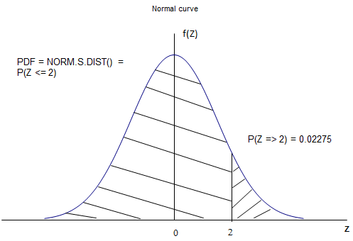
Example 3.5 Excel solution
Example 3.3 consisted of solving the problem, P(X ≥ 110), with μ = 100 and σ = 5.
Using equation (3.6) we can replace X with Z,
P(X ≥ 110) = P(Z ≥ + 2).
The value of P(Z ≥ 2) can be calculated using Excel’s NORMS.DIST () function.

Slide 15
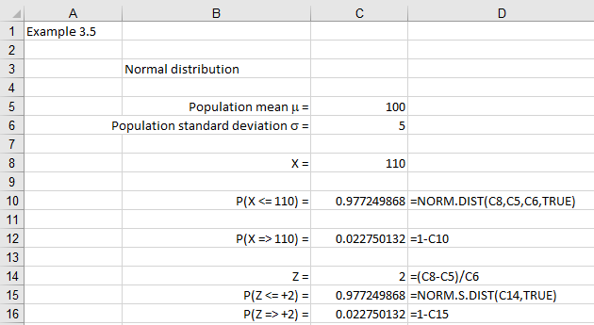
Excel solution continued
From Excel, P(X ≥ 110) = P(Z ≥ +2) = 0.02275 or 2.3%

Slide 16
Normal distribution critical table
If we did not use Excel but relied on tables, the value of this probability P(X ≥ 110) can be found from critical tables if we convert P(X ≥ 110) to P(Z ≥ 2) and use the normal distribution critical table, as illustrated in Table 3.3, to look up P(Z ≥ 2).
Z | 0.00 | 0.01 | 0.02 | 0.03 | 0.04
0.0 | 0.500 | 0.496 | 0.492 | 0.488 | 0.484
0.1 | 0.460 | 0.456 | 0.452 | 0.448 | 0.444
0.2 | 0.421 | 0.417 | 0.413 | 0.409 | 0.405
1.8 | 0.036 | 0.035 | 0.034 | 0.034 | 0.033
1.9 | 0.029 | 0.028 | 0.027 | 0.027 | 0.026
2.0 | 0.023 | 0.022 | 0.022 | 0.021 | 0.021
2.1 | 0.018 | 0.017 | 0.017 | 0.017 | 0.016
From Table 3.3, P (Z ≥ 2) = 0.023.

Slide 17
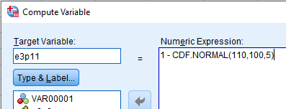

SPSS solution
Note that in these examples we have no data to input but we must enter a data value to be able to use the methods described below. In this example, we have entered the number 1 into column 1 (VAR00001).
Now we can use SPSS Statistics to calculate the associated probabilities.
Select Transform > Compute Variable
Target Variable: e3p11
Numeric expression = 1-CDF.NORMAL (110, 100, 5)
The value will not be in the SPSS output file but in the SPSS data file in a column called e3p11
The probability that an individual tube length is at least 110 cm is 0.02275 (or 2.3%).

Slide 18
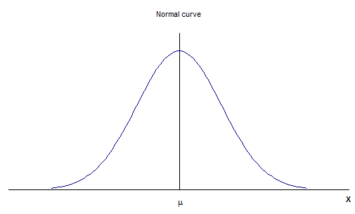
Empirical rules
For a normal distribution we can show that a simple relationship exists between the number (or proportion) of data points, the population mean value (μ), and the population standard deviation (σ).
For a normal distribution the middle (average) value is the population mean, μ, with the data points (or values) symmetrically and evenly spread out either side of this mean value. For one standard deviation either side of this mean value will contain approximately 34% of all the data values.
Empirical rules:
μ ± σ ≈ 68% of data values
μ ± 2σ ≈ 95% of data values
μ ± 3σ ≈ 99.7% of data values

Slide 19
Checking for Normality – Normal Probability plot
The issue of checking whether the population is normally distributed is an important concept and can be achieved by either: constructing a five-number summary (or box plot – see chapter 2), and/or constructing a normal probability plot.
Normal Probability Plot
A normal probability plot consists of constructing a graph of data values against a corresponding Z value where Z is based upon the ordered value.
Example 3.7
The manager at BIG JIMS restaurant is concerned at the time it takes to process credit card payments at the counter by counter staff. Construct a normal probability plot to check if data normally distributed.
Processing credit cards (n= 19)
0.64 | 0.71 | 0.85 | 0.89 | 0.92
0.96 | 1.07 | 0.76 | 1.09 | 1.13
1.23 | 0.76 | 1.18 | 0.79 | 1.26
1.29 | 1.34 | 1.38 | 1.50

Slide 20
Normal probability plot (continued) – How to?
The method to create the normal probability plot is as follows:
Order the data values (1, 2, 3, , n) with 1 referring to the smallest data value and n representing the largest data value
For the first data value (smallest) calculate the cumulative area using the formula: = 1/ (n+1)
Calculate the value of Z for this cumulative area using the Excel Function: =NORMSINV (Z value)
Repeat for the other values where the cumulative area is given by the formula: =old area + 1/(n+1)
Input data values with smallest to largest value
Plot data value y against Z value for each data point.

Slide 21
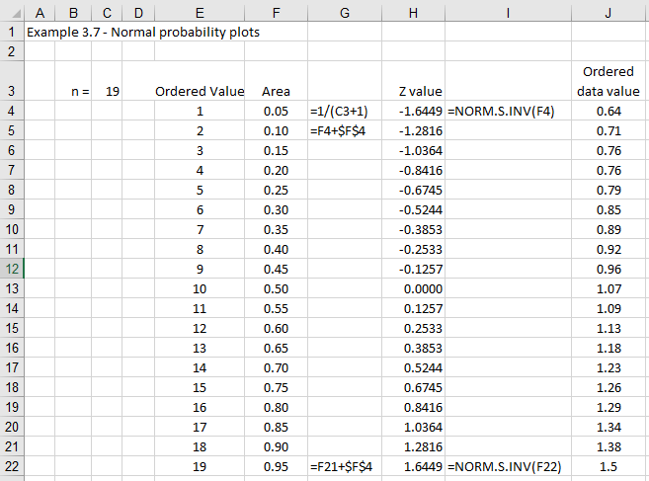
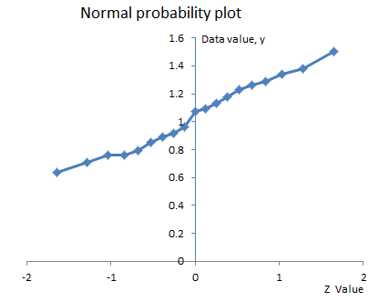
Normal probability plot – Excel solution
Excel solution: Ordered data value against z value
We observe from the graph that the relationship between the data values and Z is approximately a straight line. For data that is normally distributed we would expect the relationship to be linear. In this situation, we would conclude that the data values are approximately normally distributed.

Slide 22
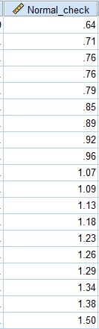
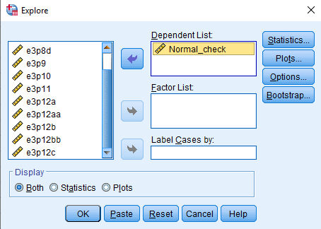
Normal probability plot – SPSS solution
Enter data into SPSS into one column – I have called the column variable Normalcheck
Select Analyze > Descriptive Statistics > Explore
Transfer variable into Dependent List box
Click on Plots
Click on Normality plots with tests

Slide 23
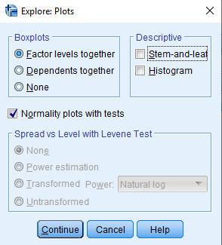
SPSS solution continued
Click Continue
Click OK

Slide 24
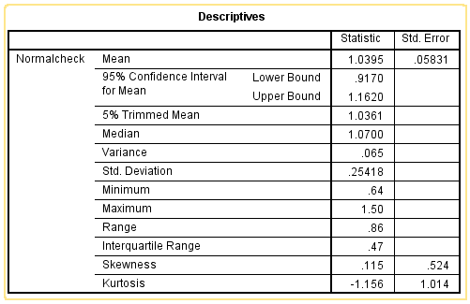
SPSS solution continued - descriptives
This will output: (a) descriptive statistics, (b) tests of normality, (c) Histogram, and (d) normal q-q plot.
From Figure 3.43, the skewness = 0.115 and kurtosis = - 1.156.
Inference (see Chapter 2 PPT)
We would expect the ratio of the value of skewness to its standard error to lie within the range ± 1.96 if you want to develop a 95% confidence interval.
In this example, skewness/skewness standard error = 0.115/0.524 = 0.2 which lies within the zone (- 1.96 to + 1.96) for us to state that the data is approximately normally distributed.

Slide 25
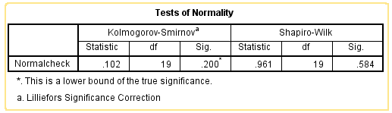
SPSS solution – Shapiro-Wilk test
SPSS provides two tests for normality: Kolmogorov-Smirnov test and the Shapiro-Wilk test.
The Shapiro-Wilk Test is more appropriate for small sample sizes (< 50 samples) but can also handle sample sizes as large as 2000.
For this reason, we will use the Shapiro-Wilk test as our numerical means of assessing normality. If the p-value (Sig. value) of the Shapiro-Wilk Test is greater than 0.05, the data is approximately normally distributed. If it is below 0.05, the data significantly deviates from a normal distribution.
In this example, the significance value = 0.584 > 0.05, and we conclude that the data is approximately normally distributed.

Slide 26
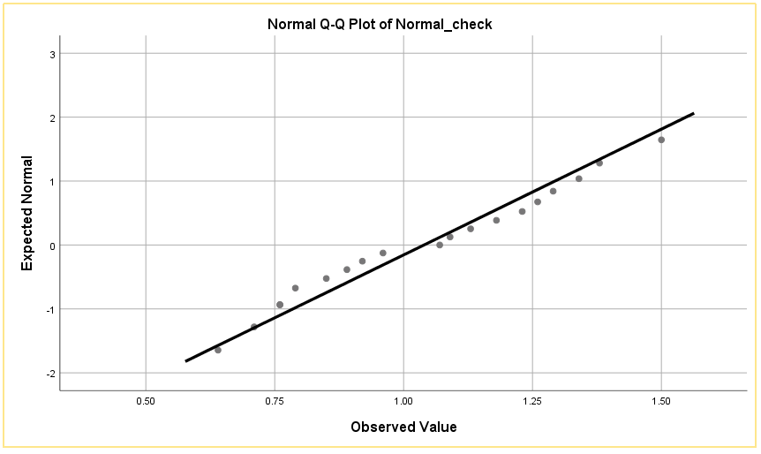
SPSS solution – continued
To determine normality graphically, we can use the output of a normal Q-Q Plot. If the data are normally distributed, the data points will be close to the diagonal line. If the data points stray from the line in an obvious non-linear fashion, the data are not normally distributed.
We observe the data is approximately normally distributed. If you are at all unsure of being able to correctly interpret the graph, rely on the numerical methods instead because it can take a fair bit of experience to correctly judge the normality of data based on plots.

Slide 27
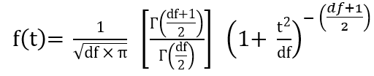
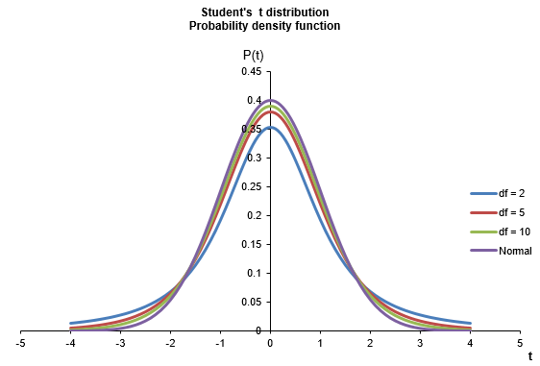
Student’s t distribution
In probability and statistics, Student’s t-distribution (or simply t-distribution) is any member of a family of continuous probability distributions that arises when estimating the mean of a normally distributed population in situations where the sample size is small and population standard deviation is unknown.
For interested readers the probability density function (pdf) of the t distribution is defined by equation (3.8)
The t-distribution is symmetric and bell-shaped, like the normal distribution, but has heavier tails, meaning that it is more prone to producing values that fall far from its mean.

Slide 28



Student’s t distribution continued
From a calculation perspective, we do not need to worry about using this equation given we have access to published tables, or software like Excel and SPSS, to undertake the calculations. If we take a sample of n observations from a continuous distributed population with population mean (μ), then the sample mean, and sample variance are given by equations (3.9) and (3.10) respectively.
Given equations (3.9) and (3.10) we can calculate the t-value using equation (3.11)
The t-distribution with n – 1 degrees of freedom is the sampling distribution of the t-value when the samples consist of independent identically distributed observations from a normally distributed population.

Slide 29
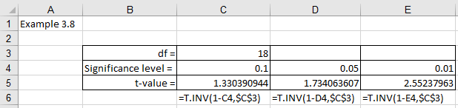
Student’s t distribution continued
Example 3.8
A sample has been collected from a normal distribution where the population standard deviation is unknown. After careful consideration, the business analyst decides that a t-test would be appropriate to undertake the required analysis. Use Excel and SPSS to calculate the value of the t statistic (assuming all the area is in the upper right-hand tail), when the number of degrees of freedom is 18 and with a significance level of 0.1, 0.05, and 0.01.
Excel Solution

Slide 30


Student’s t distribution continued
SPSS solution
Select Transform > Compute Variable
Target Variable: e3p14a
Numeric expression = IDF.T(1-0.1,18)
Click OK
The value will not be in the SPSS output file but in the SPSS data file in a column called e3p14a
The t-value for a t distribution with 18 degrees of freedom is 1.33 when the significance level in the right-hand tail is 0.1.

Slide 31

F distribution
In probability theory and statistics, the F-distribution, also known as Snedecor's F distribution or the Fisher–Snedecor distribution (after Ronald Fisher and George W. Snedecor) is another continuous probability distribution. You will see in the chapters that follow that this distribution arises frequently as the null distribution of a test statistic, most notably in the analysis of variance, e.g. F-test.
The F test statistic is defined by equation (3.12)
Where s₁² and s₂² are the sample 1 and sample 2 variances respectively. The shape of the distribution depends upon the numerator and denominator degrees of freedom (df₁ = n₁ - 1, df₂ = n₂ - 1) and the F distribution is written as a function of n₁, n₂ as F (n₁, n₂).

Slide 32
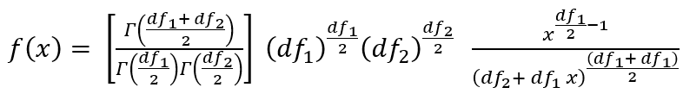
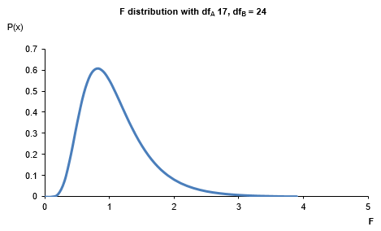
F distribution continued
The probability density function (pdf) of the F distribution is defined by equation (3.13)
Where x > 0, and $\text{Γ}\left(\text{df}\right) \text{denotes} \text{the} \text{gamma} \text{function}\text{ = }\left(\text{df}\text{−}\text{1}\right)\text{!}$
From a calculation perspective, we do not need to worry about using this equation given we have access to published tables or software like Excel and SPSS to undertake the calculations.
Figure illustrates the shape of the F distribution for df_{A} = 17 and df_{B} = 24.

Slide 33
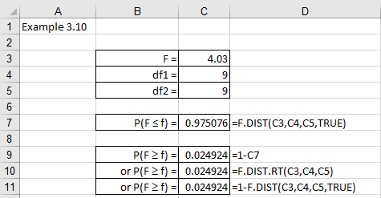
F distribution continued
Example 3.10
Calculate the probability of F ≤ 4.03 if the numerator and denominator degrees of freedom are 9, 9 respectively. Based on this answer calculate the P(F ≥ 4.03).
Excel Solution
P(F ≤ 4.03) = 0.98
P(F ≥ 4.03) = 0.02
SPSS solution
Select Transform > Compute Variable
Target Variable: e3p16a
Numeric expression = CDF.F(4.03,9,9)
P(F ≤ 4.03) = 0.98
P(F ≥ 4.03) = 0.02
Select Transform > Compute Variable
Target Variable: e3p16b
Numeric expression = 1-CDF.F(4.03,9,9)

Slide 34
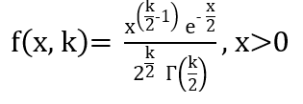
Chi-square distribution
The Chi-square distribution is a popular distribution that is used to solve many statistical inference problems involving contingency tables and assessing the significance of a model to sample data (goodness-of-fit).
The probability density function (pdf) of the chi-square distribution is defined by equation (3.15):
Where x > 0, $Γ$() denotes the Gamma function that we already introduced.
From a calculation perspective, we again do not need to worry about using this equation given we have access to published tables or software like Excel and SPSS to undertake the calculations.

Slide 35
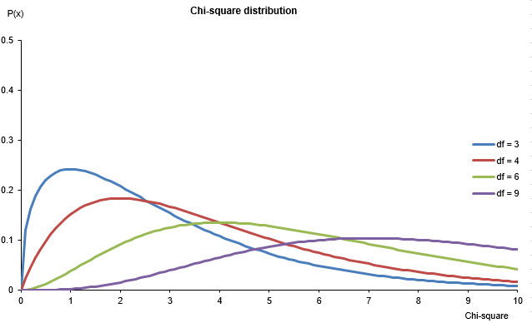
Chi-square distribution continued
Figure 3.71 illustrates the variation in the value of the F distribution with a change on the number of degrees of freedom varying between 3 and 9.

Slide 36
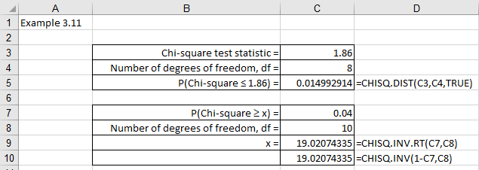
Chi-square distribution continued
Example 3.11
Calculate the probability that the chi-square test statistic ≤ 1.86 if the number of degrees of freedom = 8. Find the value of x given P(chi-square test statistic ≥ x) = 0.04 and 10 degrees of freedom.
Excel Solution
We can see that P(Chi-square test statistic ≤ 1.86) with 8 degrees of freedom results with probability = 0.015 and P(Chi-square test statistic ≥ x) = 0.04 with 10 df gives x = 19.02.

Slide 37
Chi-square distribution continued
SPSS solution
P(Chi-square ≤ 1.86)
Select Transform > Compute Variable
Target Variable: e3p17a
Numeric expression =CDF.CHISQ(1.86, 8)
The value will not be in the SPSS output file but in the SPSS data file in a column called e3p17a. P(Chi-square ≤ 1.86) = 0.015.
P(Chi-square ≥ x)
Select Transform > Compute Variable
Target Variable: e3p17b
Numeric expression =IDF.CHISQ(1-0.04, 10)
The value will not be in the SPSS output file but in the SPSS data file in a column called e3p17b. P(Chi-square test statistic ≥ x) = 0.04 with 10 df gives x = 19.02.

Slide 38
Discrete Probability Distributions
In this section we shall explore probability distributions when dealing with discrete random variables.
Two specific distributions will be discussed in this section:
Binomial probability distributions
Poisson probability distributions
We will also explore how to approximate one distribution with another, if appropriate.

Slide 39
Binomial Probability Distribution
One of the most elementary discrete random variables - Binomial - is associated with questions that only allow 'Yes' or 'No' type answers, or a classification such as male or female, or recording a component as defective or not defective. If the outcomes are also independent, e.g. the possibility of a defective component does not influence the possibility of finding another defective component then the variable is considered to be a Binomial variable.
Characteristics of the Binomial distribution:
The experiment consists of n identical trials.
Each trial results in one of two outcomes which for convenience we can define as either a success or a failure.
The outcomes from trial to trial are independent.
The probability of success (p) is the same for each trial.
The probability of failure (q), where q = 1 - p.
The random variable equals the number of successes in the n trials and can take the value from 0 to n.

Slide 40


Binomial Probability Formula
Example 3.14
A marksman shoots 3 rounds at a target. His probability of getting a 'bull' is 0.3. Develop the probability distribution for getting: 0, 1, 2, 3, 'bulls'. This experiment can be modelled by a Binomial distribution since:
3 identical trials (n = 3)
Each trial can result in either a bull (success) or not a 'bull' (failure)
The outcome of each trial is independent
The probability of a success (P(a bull) = p = 0.3) is the same for each trial
The random variable is discrete
Equation (3.20) gives the binomial probability of calculating ‘r’ successes in ‘n’ trials with the probability of success on each trial ‘p’.
The term $\left(\begin{matrix}\text{n} \\ \text{r}\end{matrix}\right)$ represents the number of combinations of selecting ‘r’ objects out of n objects.
$$\left(\begin{matrix}\text{n} \\ \text{r}\end{matrix}\right)\text{=}\text{n}\text{!/}\text{r}\text{!(}\text{n}\text{−}\text{r}\text{)!}$$

Slide 41
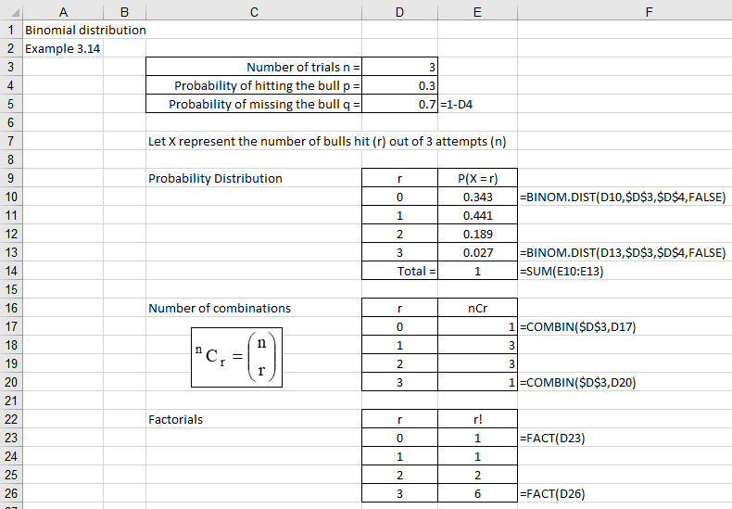
Excel solution
We observe that the probability values, P(X=r), can be calculated using equation (3.20) or via the Excel function BINOM.DIST ().
It is important to note that the mean and variance of the Binomial distribution are easily calculated using equations (3.23) and (3.24):
E(X) = np
VAR(X) = npq

Slide 42
SPSS solution
P(X = 3 given binomial and n = 3, p = 0.3)
Select Transform > Compute Variable
Target Variable: e3p18a
Numeric expression = PDF.BINOM(3, 3, 0.3)
P(X = 3 given binomial and n = 3, p = 0.3) = 0.027
P(X ≤ 2 given binomial and n = 3, p = 0.3)
Select Transform > Compute Variable
Target Variable: e3p18b
Numeric expression = CDF.BINOM(2,3,0.3)
P(X ≤ 2 given binomial and n = 3, p = 0.3) = 0.973

Slide 43
Poisson Probability Distribution
In the previous section we explored the concept of a binomial distribution which represents a discrete probability distribution that enables the probability of achieving ‘r’ successes from ‘n’ independent experiments to be calculated. Each experiment (or event) has two possible outcomes (‘success’ or ‘failure’) and the probability of ‘success’ (p) is known.
The Poisson distribution developed by Simeon Poisson (1781-1840) is a discrete probability distribution that enables the probability of ‘r’ events to occur during a specified interval (time, distance, area, and volume) if the average occurrence is known and the events are independent of the specified interval since the last event occurred.

Slide 44
Poisson Probability Formula
Equation (3.25) enables Poisson probability problems to be solved.
Where:
P(X = r) is the probability of event ‘r’ occurring
The symbol ‘r’ represents the number of occurrences of an event and can take the value 0 → ∞ (infinity).
r! is the factorial of ‘r’ calculated using the Excel function: FACT ().
λ is a positive real number that represents the expected number of occurrences for a given interval. For example, if we found that we had an average of 4 stitching errors in a 1 metre length of cloth, then for 2 metres of cloth we would expect the average number of errors to be λ = 4*2 = 8.
The symbol ‘e’ represents the base of the natural logarithm (e = 2.71828...).

Slide 45
Example 3.15
The following data, derived from the past 100 years, concerns the number of times a river floods in a wet season.
Check if the distribution may be modelled using the Poisson distribution and determine the expected frequencies for a 100 year period.
Number of Floods (X) | Number of Years with 'X' Floods (f)
0 | 24
1 | 35
2 | 24
3 | 12
4 | 4
5 | 1
Total = | 100

Slide 46
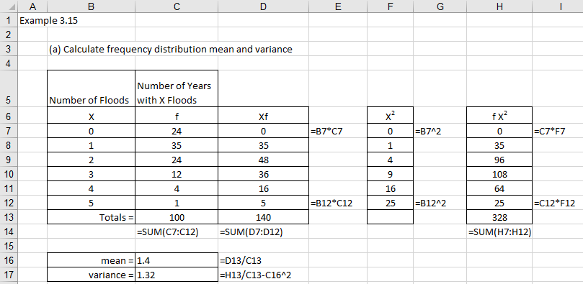
Excel solution
Step 1 Calculate mean value λ from the frequency distribution table
From Excel
λ = 1.4
Note. For a Poisson distribution the following relationship holds: mean = variance. From Excel, mean = 1.4 and variance = 1.32. Given that the two values are approximately equal then we would expect that the observed sample data will be well approximated by the predicted Poisson probability values.

Slide 47
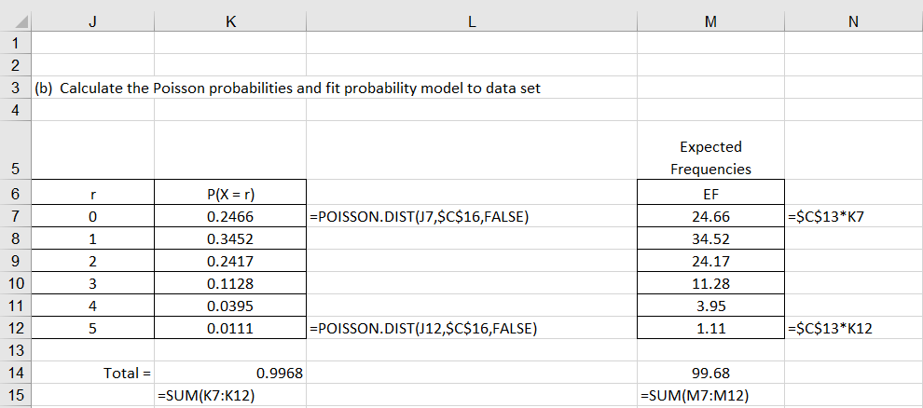
Excel solution continued
Step 2 Use λ to calculate P(X=r) and Expected Frequencies
Excel can be used to calculate the Poisson probability values by using the Excel function POISSON.DIST(). In Chapter 7 we shall describe the Chi squared goodness-of-fit test to see if the Poisson model is a significant fit to the sample data.

Slide 48
SPSS solution
Calculate the probability values P(X = x given Poisson and n = 5, mean = 1.4)
P(X = 0)
Select Transform > Compute Variable
Target Variable: e3p19b
Numeric expression = PDF.POISSON(0, 1.4)
P(X = 0) = 0.2466
Repeat for X = 1, 2, 3, 4, 5
Numeric expression = PDF.POISSON(1, 1.4) = 0.3452
Numeric expression = PDF.POISSON(2, 1.4) = 0.2417
Numeric expression = PDF.POISSON(3, 1.4) = 0.1128
Numeric expression = PDF.POISSON(4, 1.4) = 0.0395
Numeric expression = PDF.POISSON(5, 1.4) = 0.0111

Slide 49
Approximations
Undertake a Poisson approximation to the binomial distribution – when the number of binomial trials are large (n > 20) and ‘p’ is small (p < 0.1) then the Poisson distribution will provide a good approximation (Poisson mean λ = binomial mean np).
Undertake a normal approximation to the binomial distribution – when the number of binomial trials are large and ‘p’ is close to 0.5 then the normal distribution will provide a good approximation (normal mean μ = binomial mean np, normal variance = binomial variance npq).
Undertake a normal approximation to the Poisson distribution - when the poisson distribution mean λ ≥ 5 will provide a good approximation (normal mean μ = Poisson mean λ).

Slide 50
Frequently used probability distributions
Table summarises most frequently used probability distributions according to whether the data variables are discrete or continuous and whether the distributions are symmetric or skewed.
 | Variable type
Measured characteristic | Discrete distributions |  | Continuous distributions
Shape | Symmetric | Skewed | Symmetric | Skewed
Distributions | Uniform Binomial | Poisson Hypergeometric | Uniform Student’s t Normal | F Exponential

Slide 51
Conclusion
In this presentation we explored the concept of probability with special emphasis on probability distributions:
Introduction to Probability
Continuous probability distributions
Discrete probability distributions

